Slide 1
DROUGHT REPORTING & INFORMATION

Slide 2
TRAINING OVERVIEW
DROUGHT REPORTING & INFORMATION
INTRODUCTION
TO DRI
NECESSITY OF DROUGHT
CONDITION REPORTING
WHAT TO REPORT
TO DRI
DRI CONDITION CATEGORIZATIONS
US Drought Monitor Product

Slide 3
DROUGHT REPORTING & INFORMATION
DROUGHT
REPORTING &
INFORMATION
A collaborative effort between the agriculture and weather/climate communities.
An easy-to-use, interactive method of reporting drought conditions to NOAA (National Weather Service) and editors of the US Drought Monitor Product.
Enhances drought forecasting, monitoring, and response.
hello@reverta.com

Slide 4
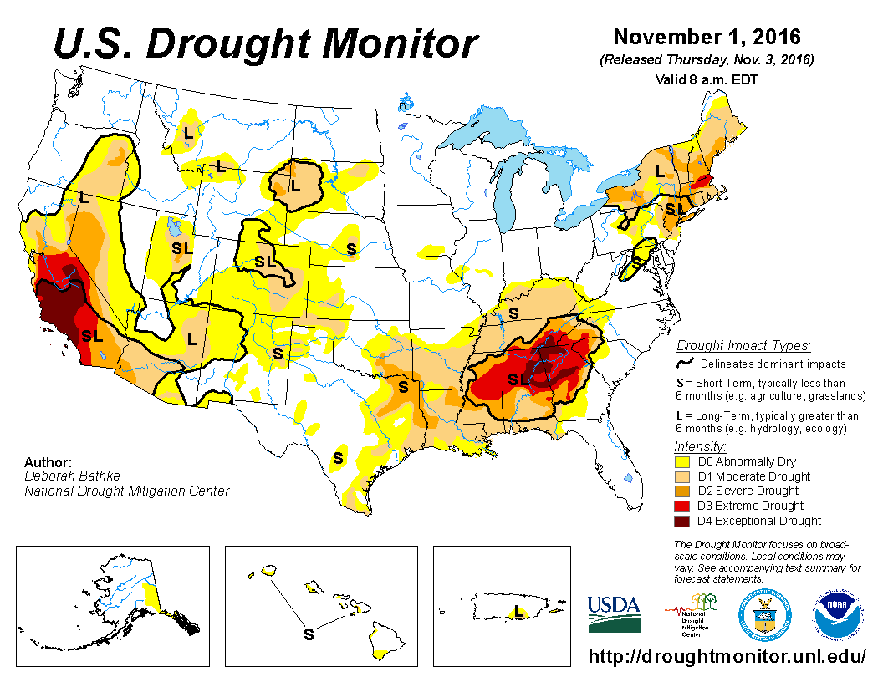
US DROUGHT MONITOR
DROUGHT REPORTING & INFORMATION
National product displaying areas of drought & severity.
Issued every Thursday morning at
7AM CT.
http://droughtmonitor.unl.edu

Slide 5
DROUGHT REPORTING & INFORMATION
US
DROUGHT
MONITOR
PRODUCTION
Produced jointly by NOAA, USDA, and the National Drought Mitigation Center (NDMC).
Based on measurements of climatic, hydrologic, and soil conditions in addition to input from over 350 contributors.
Contributors from academia, agriculture, government agencies, etc.
hello@reverta.com

Slide 6
DROUGHT REPORTING & INFORMATION
US
DROUGHT
MONITOR
USE
Used by policymakers and media in discussing drought and in drought relief planning.
Used in disaster declarations for areas experiencing ‘severe’ drought for an extended period of time.
Has been used to distribute billions of dollars in federal money to farm and livestock relief.
hello@reverta.com

Slide 7
DROUGHT REPORTING & INFORMATION
“It isn’t a strictly quantitative product… the community of drought observers lends credibility to the state-of-the-art blend of science and subjectivity that goes into the map.”
http://droughtmonitor.unl.edu/
“About USDM”
US
DROUGHT
MONITOR
CREDIBILITY
In other words, your reports are needed to uphold the credibility of this product.
hello@reverta.com

Slide 8
DROUGHT REPORTING & INFORMATION
THINGS TO
REPORT
VIA DRI
• Location
• Photo
• Categorization (1 of 5)
• Have conditions improved, stayed the same, or worsened?
• Narrative (Observer’s general
assessment)

Slide 9
CONDITION CATEGORIZATIONS
DROUGHT REPORTING & INFORMATION
Select one of five:
NONE
SLIGHT
MODERATE
SEVERE
DEVASTATING

Slide 10
DROUGHT REPORTING & INFORMATION
NONE
CONDITIONS
No drought conditions exist.
Moisture is abundant and crops are healthy.
No irrigation is required.

Slide 11
DROUGHT REPORTING & INFORMATION
SLIGHT
CONDITIONS
Some dry conditions exist, but impacts are minor.
Crops are healthy with minimal irrigation required.

Slide 12
DROUGHT REPORTING & INFORMATION
MODERATE
CONDITIONS
Dry conditions widely exist.
Irrigation is required, with crops not irrigated now wilting or turning.
Soil is dry with browning of grass surfaces such as yards and pastures.

Slide 13
DROUGHT REPORTING & INFORMATION
SEVERE
CONDITIONS
Conditions are extremely dry.
Some water shortages are possible.
Many crops have experienced damage or been lost, with impacts to crop yields certain.

Slide 14
DROUGHT REPORTING & INFORMATION
DEVASTATING
CONDITIONS
Conditions are
devastatingly dry.
Major crop losses have or will occur, in addition to major water shortages.
Losses to livestock are also possible.

Slide 15
DROUGHT REPORTING & INFORMATION

